Slide 1

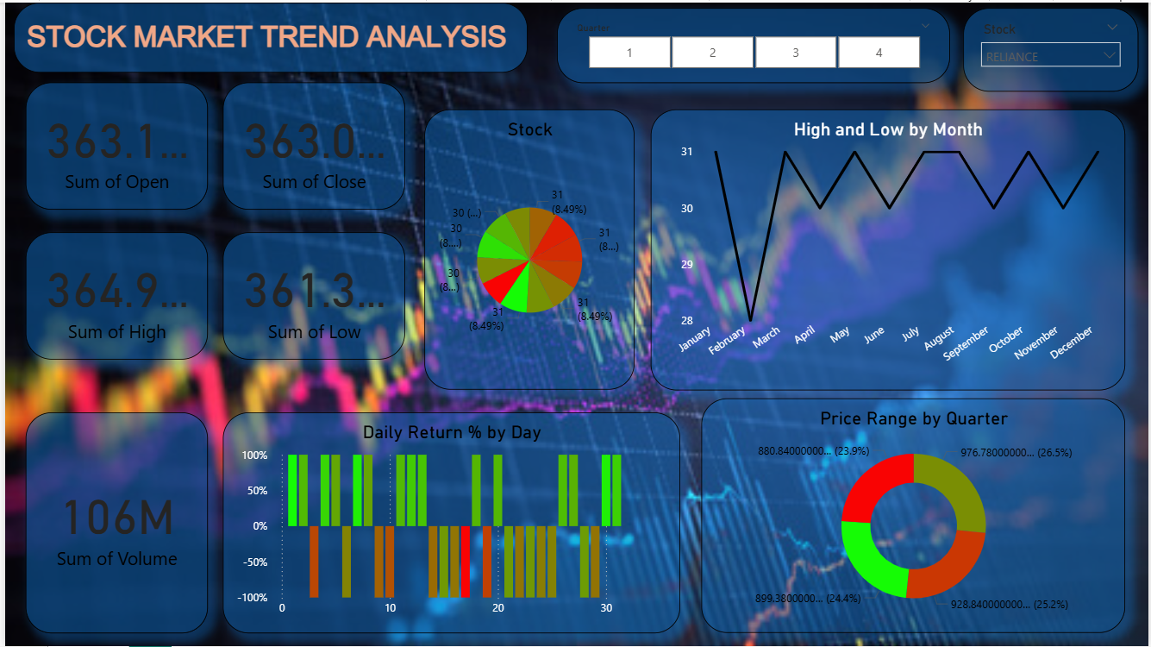
STOCK MARKET TREND ANALYSIS DASHBOARD
Objective: To provide a comprehensive, 360-degree view of the selected stock's performance and market behavior over the past year.
Overview: The stock trends for TCS, Reliance, and Infosys using Power BI.
Core Functionality (User Control): The dashboard is powered by the Dropdown/Slider interface for selecting the company and historical date range. Its core visualization components include the Monthly Price Chart, Daily Return Chart, and Price Distribution Pie Chart.

Slide 2
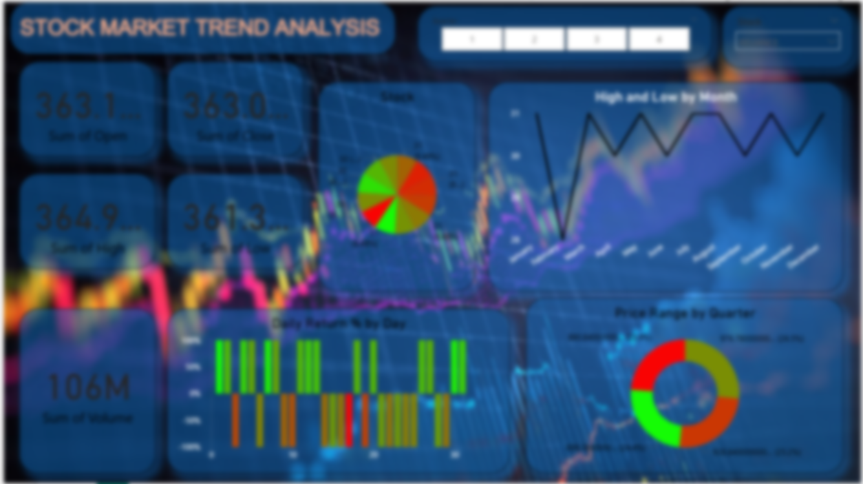
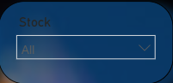
DASHBOARD OVERVIEW
Includes KPIs, line charts, bar charts, pie charts, donut charts, and slicers for dynamic analysis.
Dashboard has a company stocks dropdown Slicer.
Allows switching between TCS, Reliance, and Infosys for focused analysis.

Slide 3
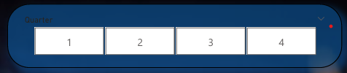
The dashboard includes an interactive slicer that allows you to filter stock data by Quarter 1, Quarter 2, Quarter 3, and Quarter 4. This slicer helps in quickly analyzing quarter-wise performance of TCS, Reliance, and Infosys, enabling clear comparison of trends across different time periods.

Slide 4
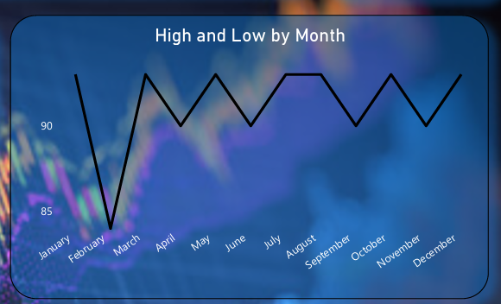
High and Low by Month Chart (Slide Content)
This visual shows the monthly high and low stock prices for the selected company.
It helps identify price fluctuations, market volatility, and trend patterns across all 12 months.
The line chart makes it easy to track rise and fall in stock performance and compare strong vs. weak months.
Useful for understanding seasonal behavior and long-term movement of the stock.

Slide 5
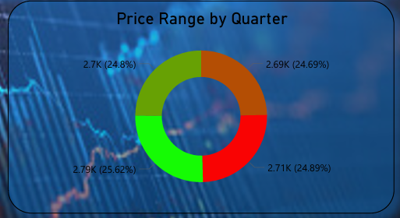
Donut Chart: Price Range by Quarter – Explanation
The donut chart shows that stock prices remained stable across all four quarters, with each quarter contributing roughly 25% to the overall price range. The values between 2.69K and 2.79K indicate minimal fluctuation, suggesting a steady and balanced market trend throughout the year. Only a slight increase is seen in Q3, but overall, the quarterly performance is consistent with no major volatility.

Slide 6
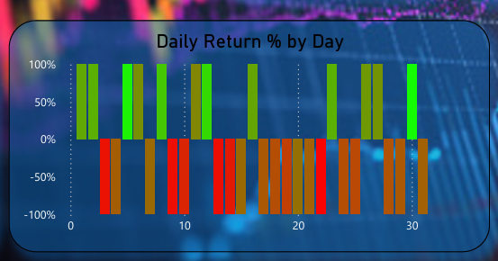
Daily Return % by Day
The chart shows high day-to-day volatility, with frequent shifts between positive (green) and negative (red/brown) returns. Some days record strong gains, while others show equally sharp losses, indicating an unstable and highly fluctuating market trend throughout the month.

Slide 7
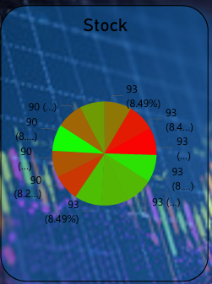
Donut
Chart
Explanation
The donut chart shows how different stock values contribute to the overall market data. Each slice represents a stock/category, with its value and percentage share. The colors highlight performance differences, helping quickly compare which segments are stronger or weaker.

Slide 8
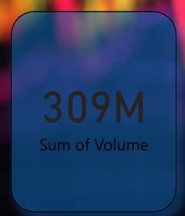
DASHBOARD HAS SOME KPI CARDS
This KPI card shows the total traded volume, which is 309 million. It highlights the overall market activity by summing all stock volumes in the dataset.

Slide 9
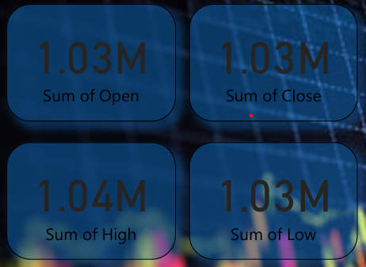
KPI Card
These KPI cards present a complete overview of stock price behavior during the trading period. The Sum of Open (1.03M) shows the total market value at the start of trading, while the Sum of Close (1.03M) reflects how the market ended. The Sum of High (1.04M) captures the combined peak prices reached across all stocks, showing the market’s maximum strength, and the Sum of Low (1.03M) represents the lowest points recorded, indicating overall market dips and volatility. Together, these metrics provide a clear picture of market movement and price fluctuations throughout the session.

Slide 10

THANK YOU
RAJ KUMAR BAURI
AJU/252070

